Slide 1
Feature Learning and Importance Scoring on Incomplete Anomaly Datasets
Bachelor Thesis Initial Presentation
Julian Hoffmeister
20/07/2022
Research Supervisor:
Andreas Lohrer
Responsible Professor:
Prof. Dr. Peer Kröger

Slide 2
RQ1 - Experiment 1
100 runs
train_val_split: [0.6, 0.65, 0.7, 0.75, 0.8, 0.85, 0.9]

Slide 3
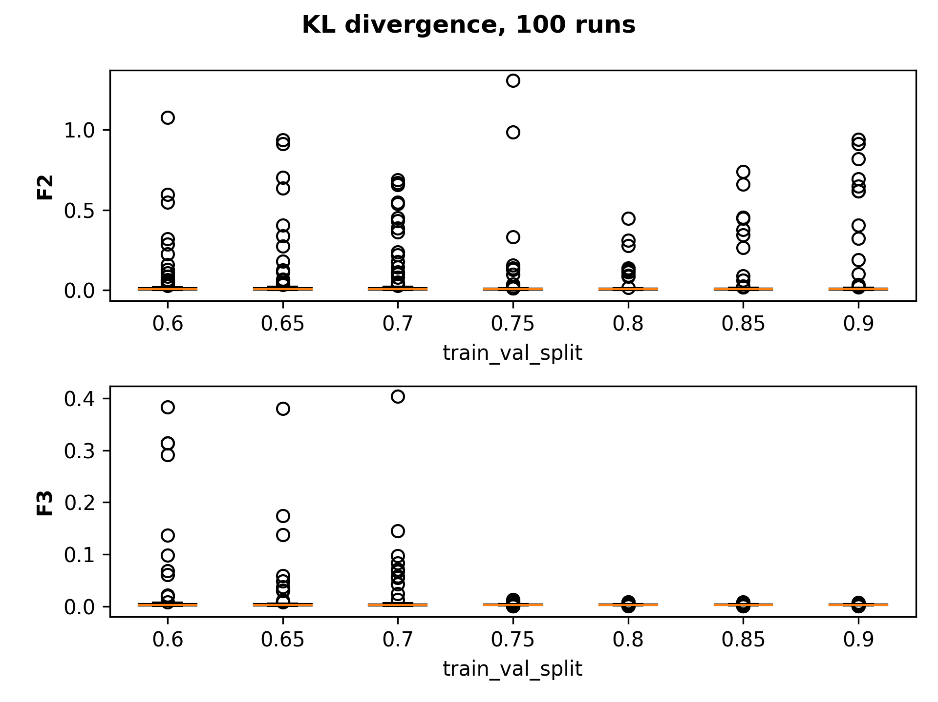
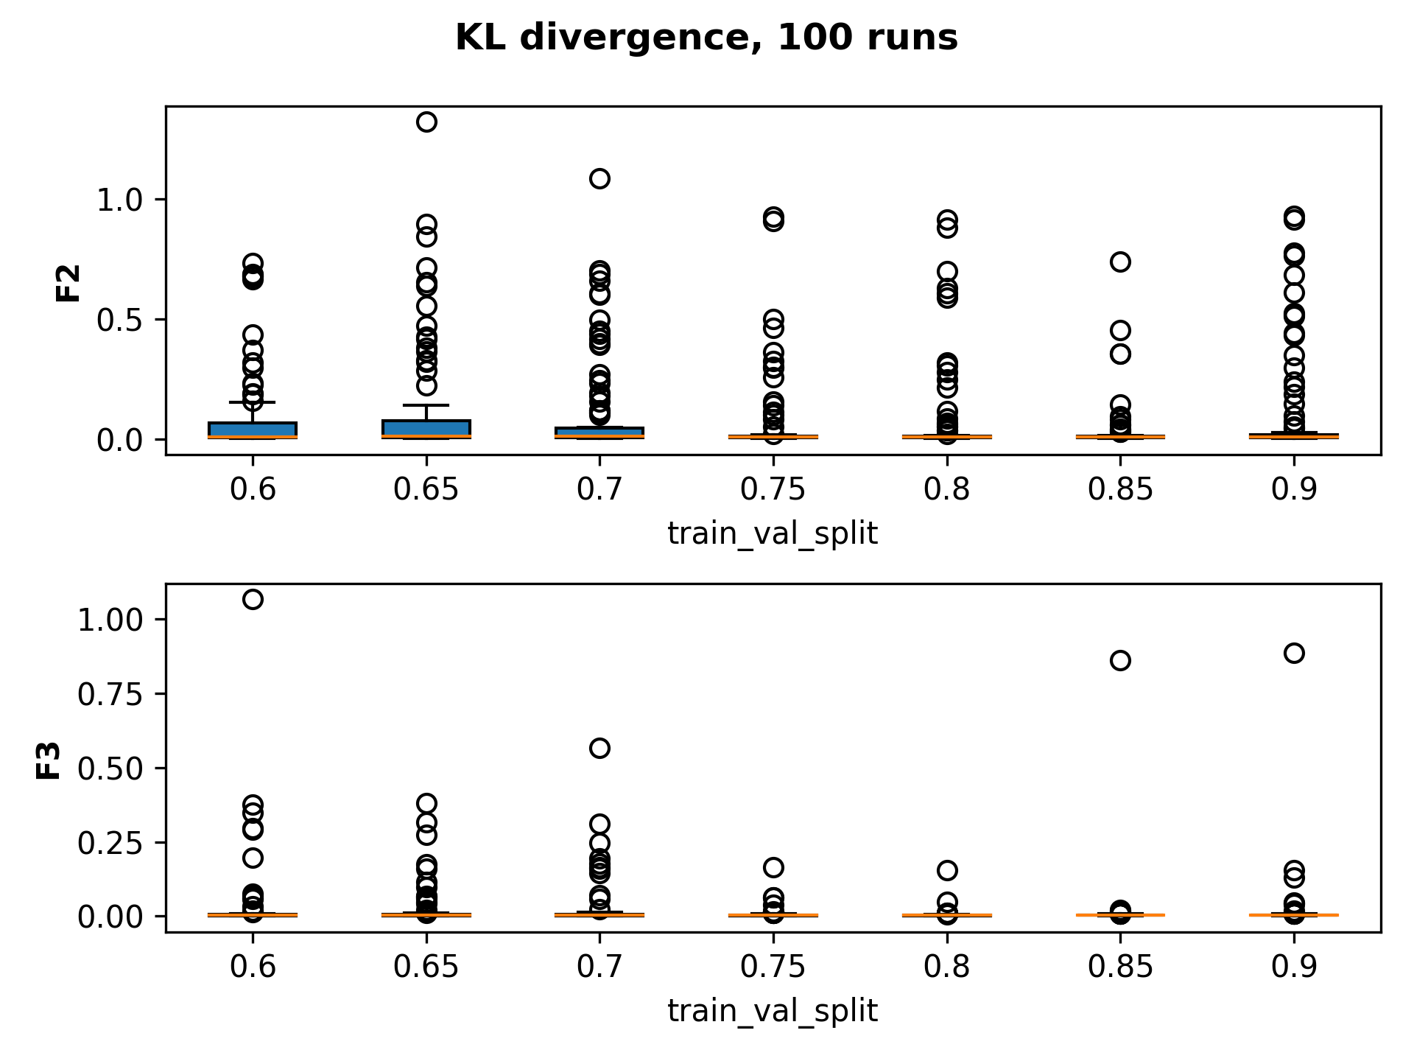
KL Divergence
RMSE
Custom Loss

Slide 4
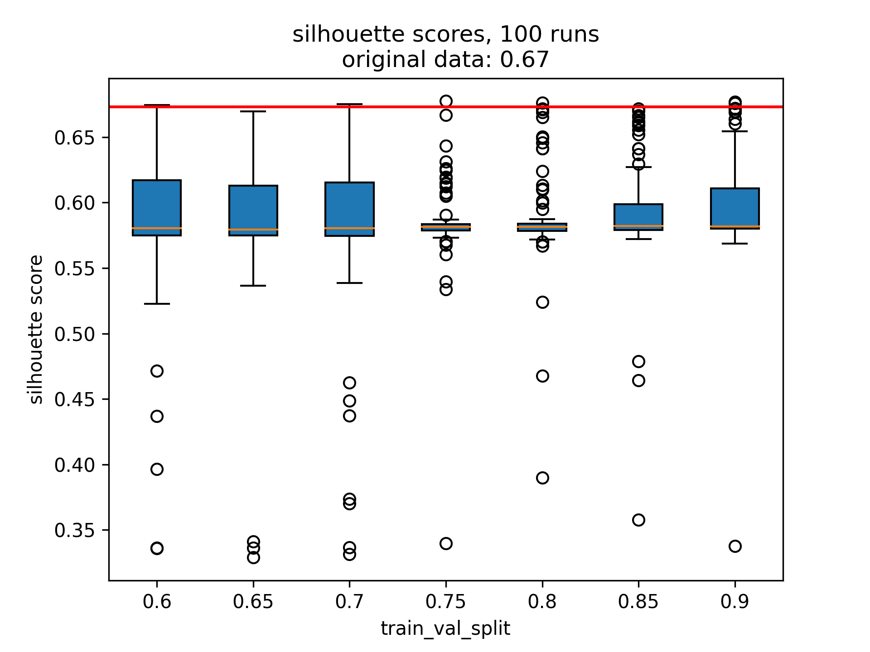
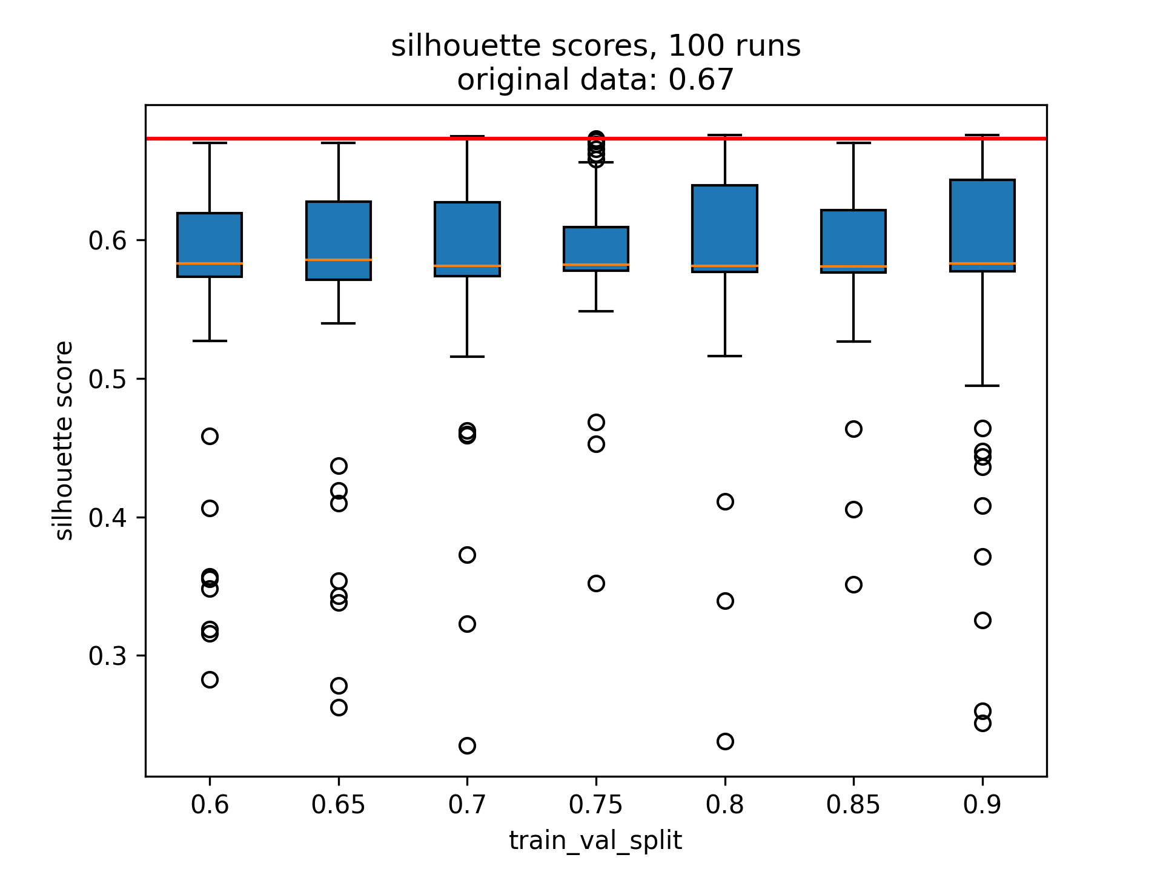
Silhouette Score
RMSE
Custom Loss

Slide 5
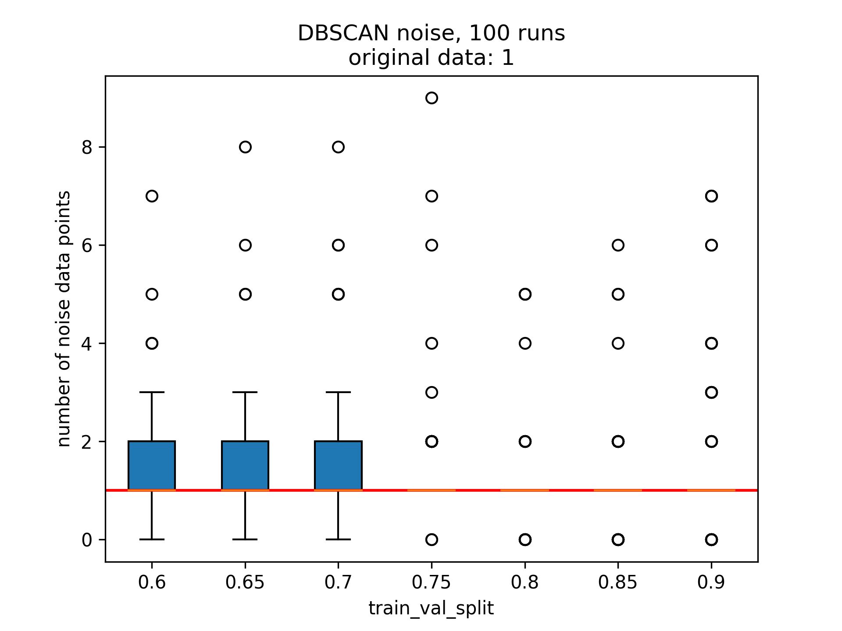
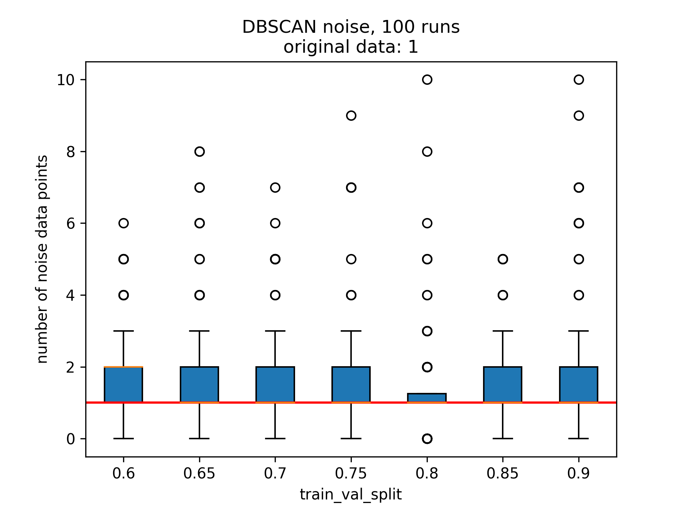
DBSCAN Noise
RMSE
Custom Loss

Slide 6
RQ1 - Experiment 2
Max_epochs: [100, 150, 200, 250, 300, 350, 400]
Train-val-split 0.75

Slide 7
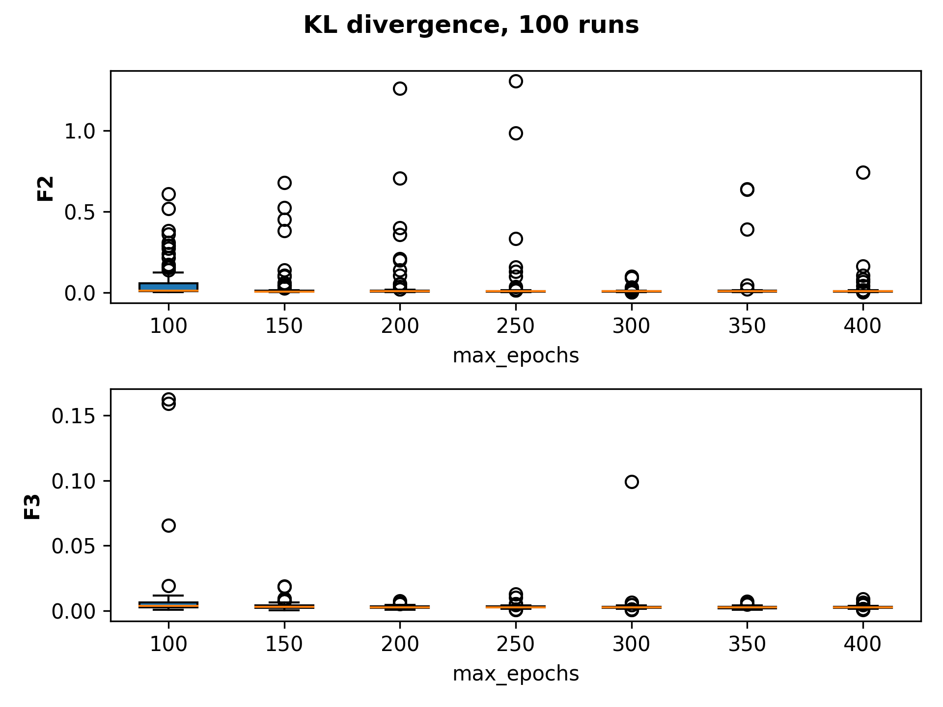
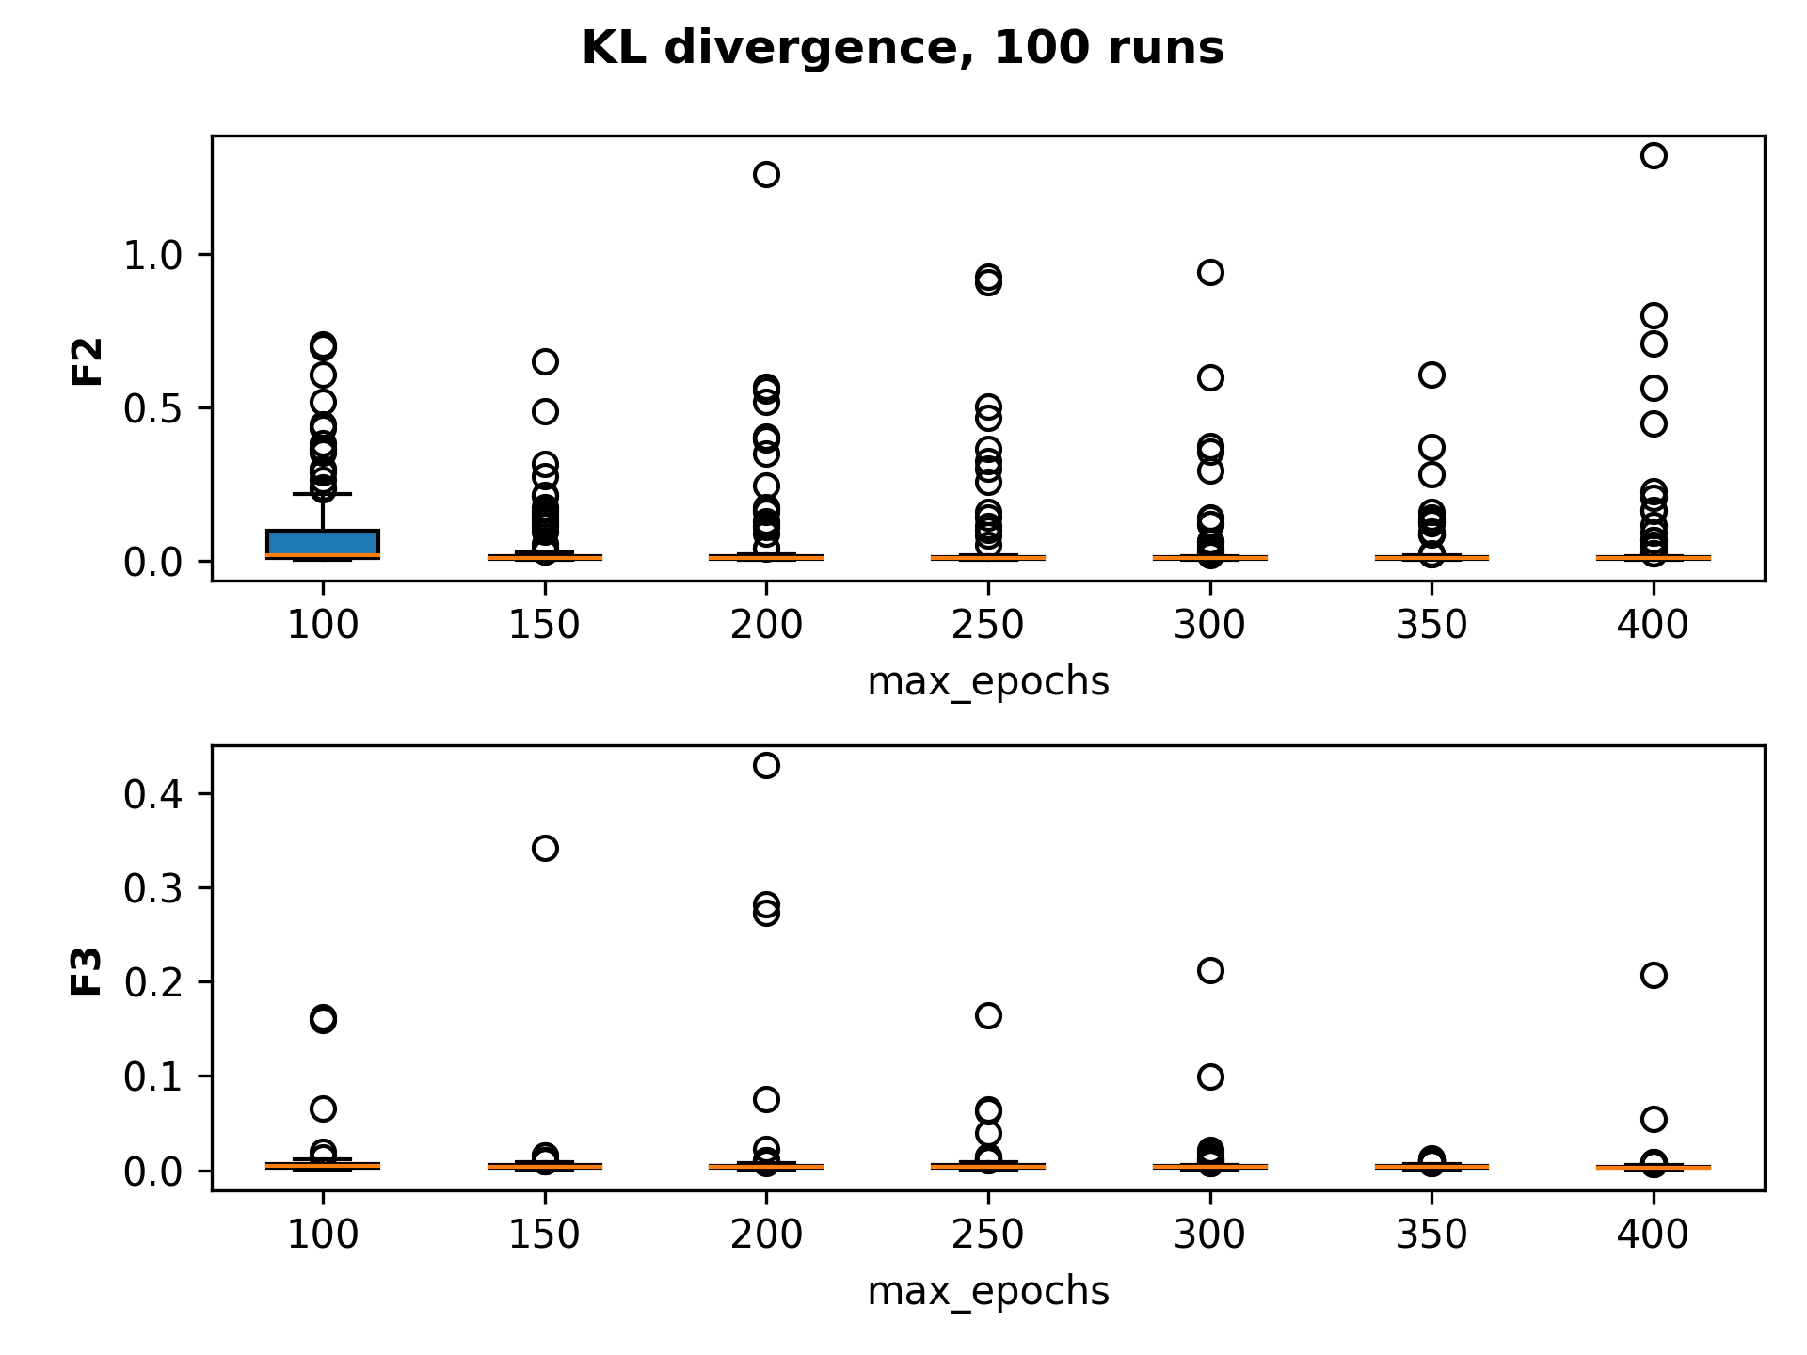
KL Divergence
RMSE
Custom Loss

Slide 8
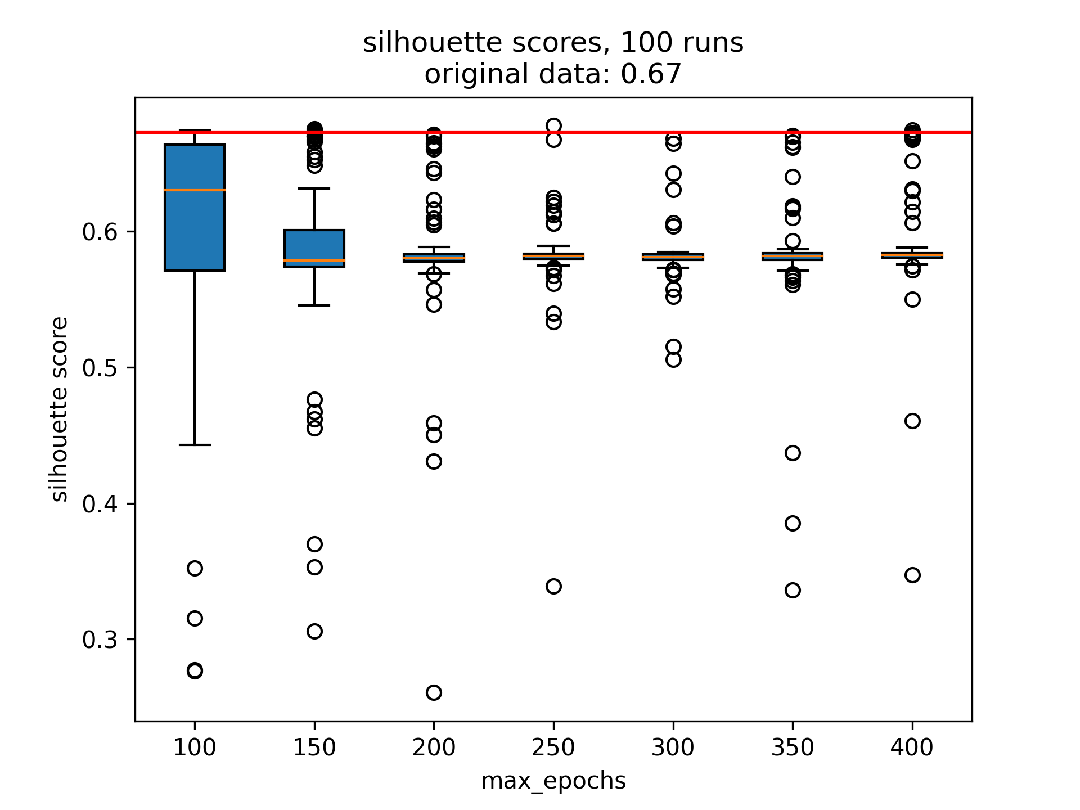
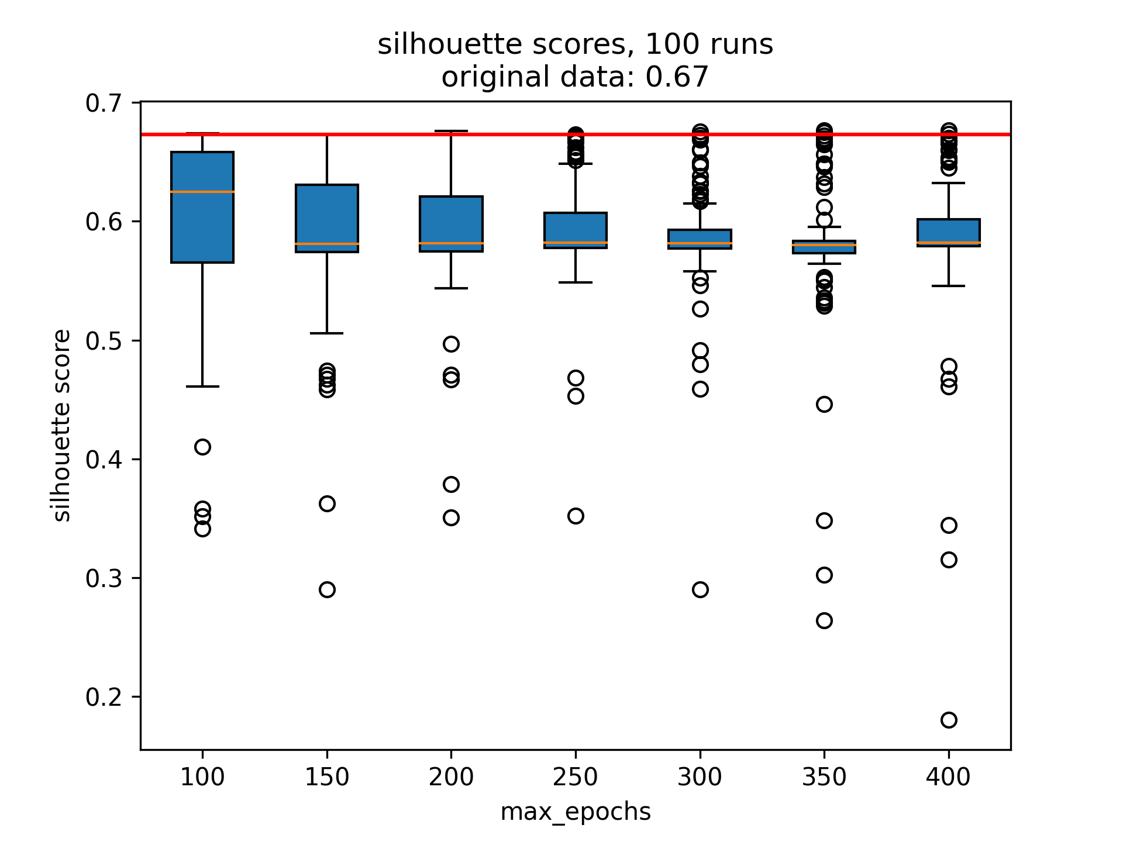
Silhouette Score
RMSE
Custom Loss

Slide 9
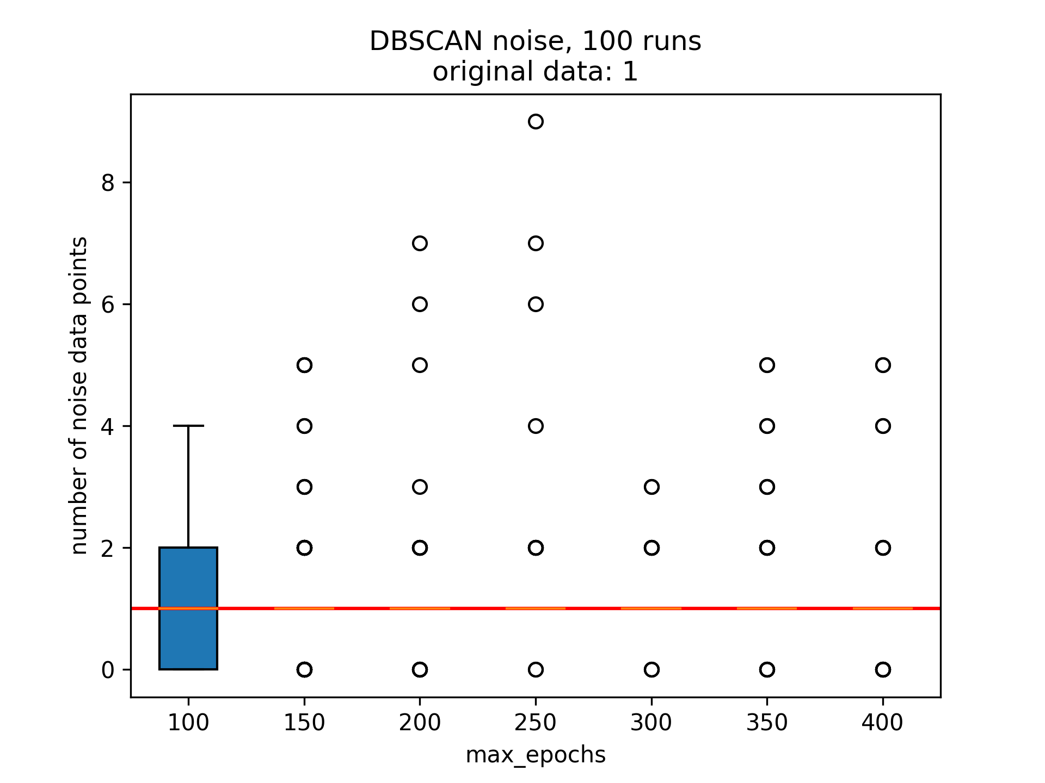
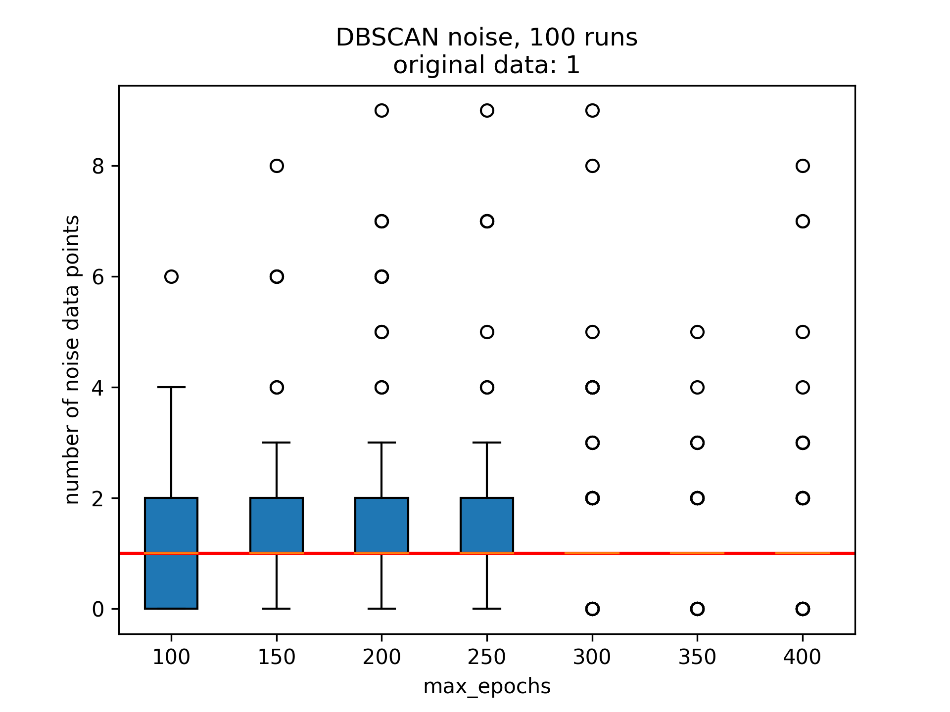
DBSCAN Noise
RMSE
Custom Loss

